Slide 1


Commercetools overview

Slide 2


Commercetools
The company
Founded 2006
New platform 2013
Berlin, Munich (HQ), Durham, Amsterdam, Jena, London, Singapore
200+ enterprise customers worldwide
200+ commerce professionals
45+ solution partners worldwide
Case Studies, Resources, White Papers
Linkedin.com/companies/commercetools
https://ok.commercetools.com/join-our-partner-program
Commercetools Platform Documentation
https://docs.commercetools.com/tutorial-GDPR#tutorial

Slide 3


The Platform
Microservices-based — consume commerce functionality (shopping cart, products, search, promotions, etc) as discrete APIs
Cloud native (100% public cloud-hosted — infinite and rapid elasticity)
API-first/API-only
Headless — build a custom UI or use a product like Adobe Experience Manager to build one
Supportive of agile development whereby small vertical teams release to production many times a day

Slide 4
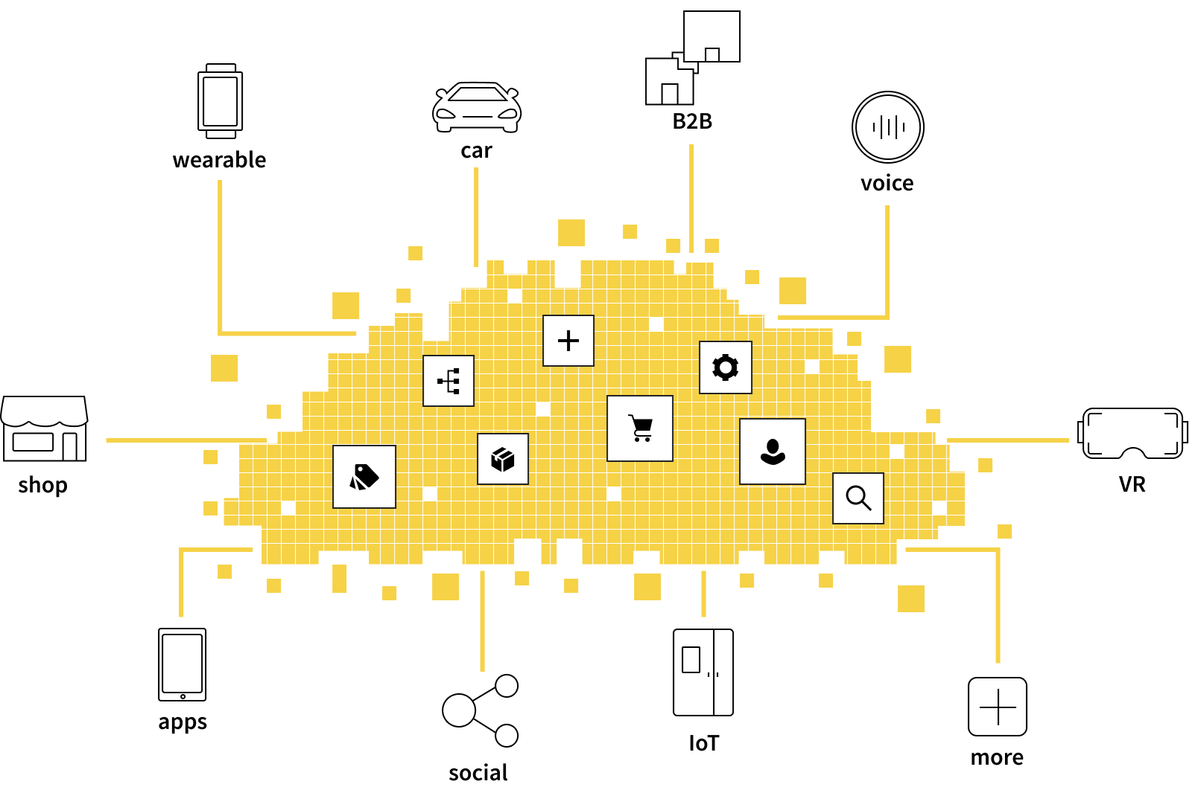
Addressing Audiences Across All Digital Touchpoints
Platform separates frontend and backend functionality
Seamless shopping experiences across all digital touchpoints
Engage with customers via webshops, mobile apps, voice assistants, AR/VR applications, social networks etc.

Slide 5
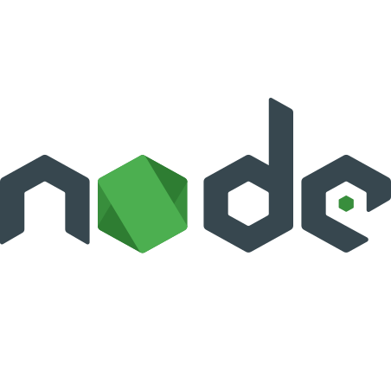

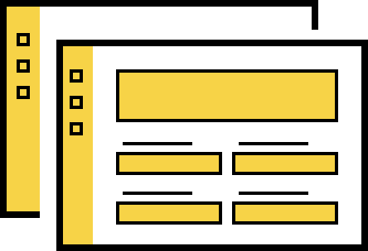









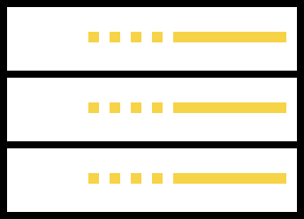




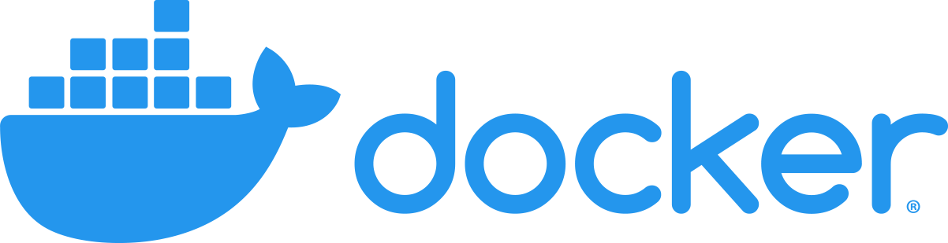


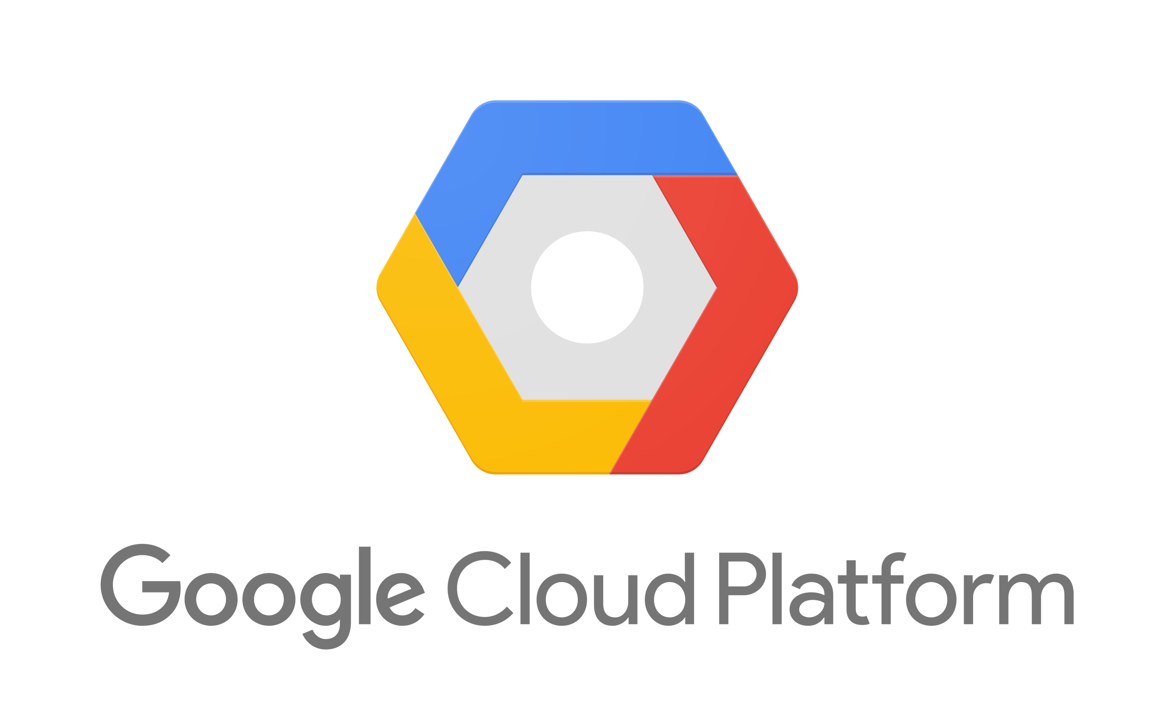

Tech Stack
Commercetools
touchpoints
UIs
SDK`s
Horizontally scalable, distributed architecture
Auto-scales
Multi-tenant
API
Back-end
Service Tier
Inaccessible
Persistence
Provisioning
Infrastructure
Cloud
Infrastructure
5

Slide 6




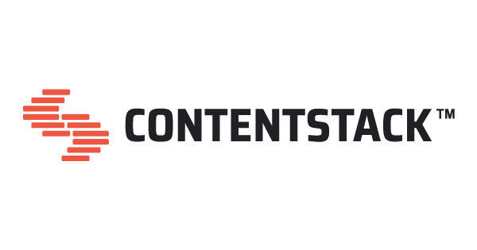






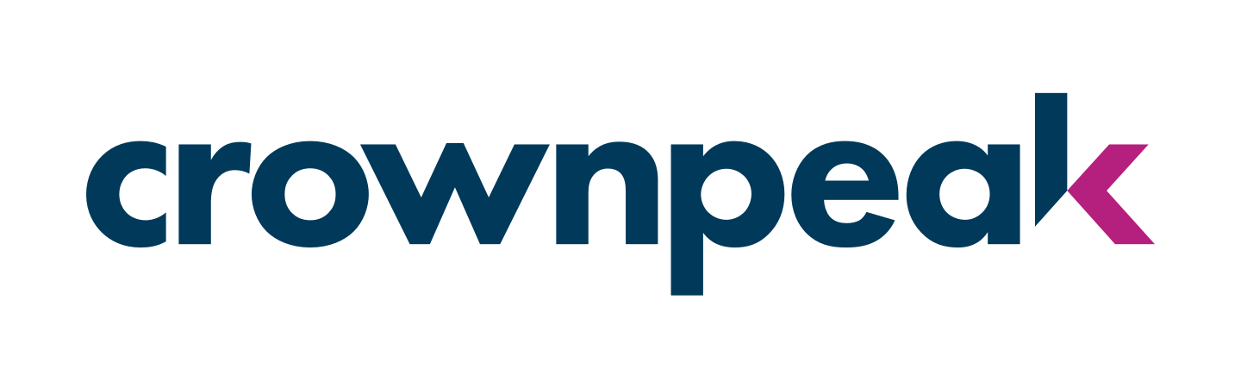

Integrations
Mobile-first Headless Front- End for commercetools
Composable commerce experiences powered by the Open Digital Experience Platform.
Amplience: a unified platform for commerce content that does everything you need it to.
The Leader in Commerce Experience™
Highest-rated enterprise headless CMS
Contentful is the next- generation content
platform to build digital experiences at scale.
SaaS solution built to create & display interactive 3D images on websites, mobile, & VR/AR apps.
Powering digital business with multiexperience orchestration of content and media.
Open Source, Git-based Dynamic CMS
The Frontend Management Platform for headless and API-first solutions
IPA.C is a ready to use,
PWA frontend accelerator for commercetools
Get there faster with cloud- first digital experiences
6

Slide 7

Core Features

Slide 8
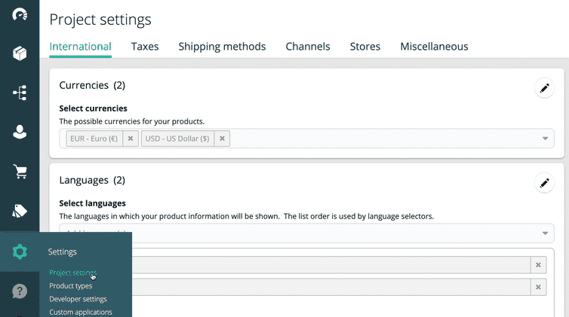
Merchant Center

Slide 9
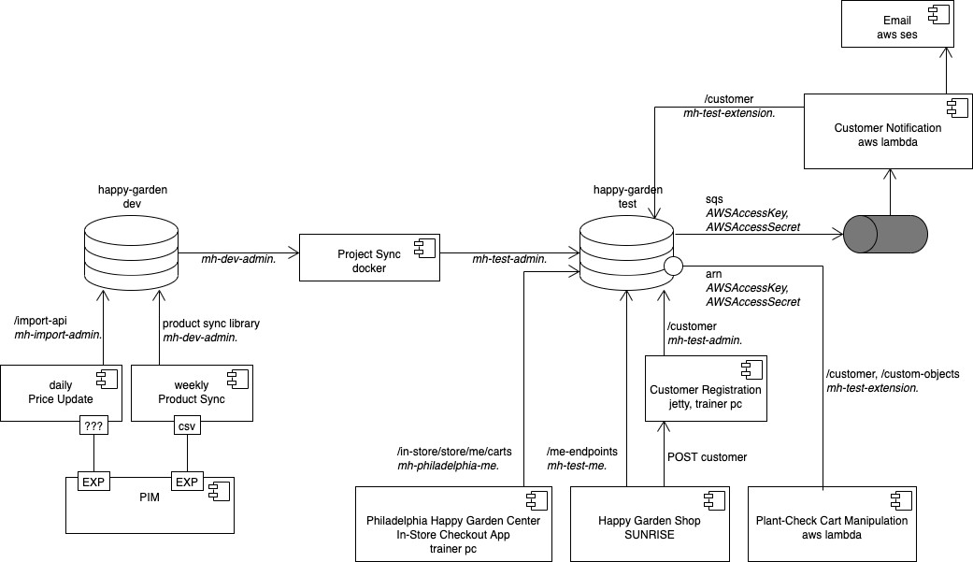





Project use case

Slide 10

Getting Organized
Organization: A logical, administrative container for projects and the people on them
Project: A closed, complete data container for an e-commerce project
MyName-training
60 day trial (learning, experiments)
isProduction
MyCompany-dev
(development project)​
isProduction
MyCompany-stage​
(uat/staging project)​
​
isProduction
MyCompany-prod​
(production project)​
isProduction
MyCompany
(Organization)
Training
(Organization)

Slide 11

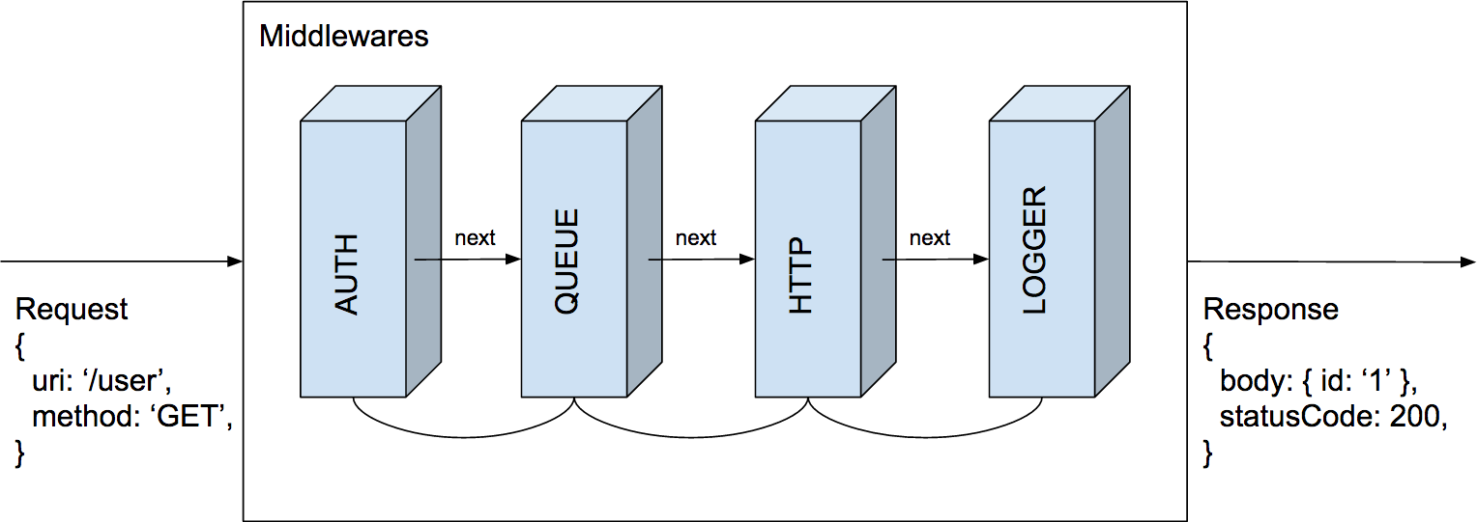
JS SDK
@commercetools/sdk-client
@commercetools/sdk-middleware-auth
@commercetools/sdk-middleware-http
@commercetools/sdk-middleware-logger
@commercetools/sdk-middleware-queue
@commercetools/sdk-middleware-user-agent
@commercetools/api-request-builder
@commercetools/sync-actions
@commercetools/get-credential
FULLY OPEN-SOURCE
www.npmjs.com/org/commercetools
www.github.com/commercetools/nodejs
HTTP client
execution of requests
transformation of requests
authorization of the request
Tracing
logging of the request
retry in case of errors
limitation of concurrent requests
Development support
Middlewares
npm install --save @commercetools/sdk-client
Notes:
https://www.contentstack.com/docs/developers/contentstack-basics/understanding-contentstack/
Understanding Contentstack
Contentstack is a CMS backend for your digital properties
Contentstack is a content management system, but a headless one. It provides the infrastructure to create and manage content, but it is not coupled to any single presentation layer, such as websites (which is commonly the case with today’s CMSs).
It is headless, which means it can serve content in a presentation-independent way. It provides REST APIs to deliver content to any channel such as websites, mobile apps, devices, marketing kiosks or any digital platform that displays content.
https://www.contentstack.com/docs/overview/why-should-you-choose-contentstack
Developer Satisfaction
Write applications using technologies, programming languages, and frameworks of their choice in the development process.
Contentstack’s rich set of RESTful APIs and SDKs for a lot of major languages makes it easier to implement websites and applications. Thus have complete control over how and where content appears.
------------------------------
Content Managers Can Work Independently
No need to bother with the presentation, instead content managers can focus on the content itself
Can create, manage, and publish content without involving developers
Update content in websites and applications, and preview change instantly and independently
------------------------------
Easy-to-use Interface
The user interface provides a plethora of editorial features such as rich text editors, live and shareable preview environments, collaborative editing, revision history, scheduled publishing, etc.
With Modular Blocks, Content Managers also has the partial ability to decide how their pages should appear
With Workflows, distribute content creation process among authorized users of your organization
------------------------------
API-driven Architecture
Deliver content to any channel and on any device at a faster rate.
Compatible with any technology.
Content in Contentstack is retrievable via APIs, so any website or application can fetch it.
Create content once and deliver it anywhere, anytime.
------------------------------
Highly Scalable
Being headless makes Contentstack capable of serving content to constantly emerging devices and touchpoints.
Higher scalability makes it possible to future-proof your content and benefits marketers without stripping them of the user experience they need to expand.
------------------------------
No Infrastructure Management Required
Easy and safe to integrate third-party applications into your websites or apps.
Users can start building their projects immediately, without having to perform any kind of setup, configuration, or maintenance activities.
------------------------------
24x7 assistance
We have a dedicated team of developers who strive to maintain both the software and the infrastructure where it’s running.
We have support engineers who provide 24x7 assistance to anyone, anytime, if something ever goes wrong.

Slide 12
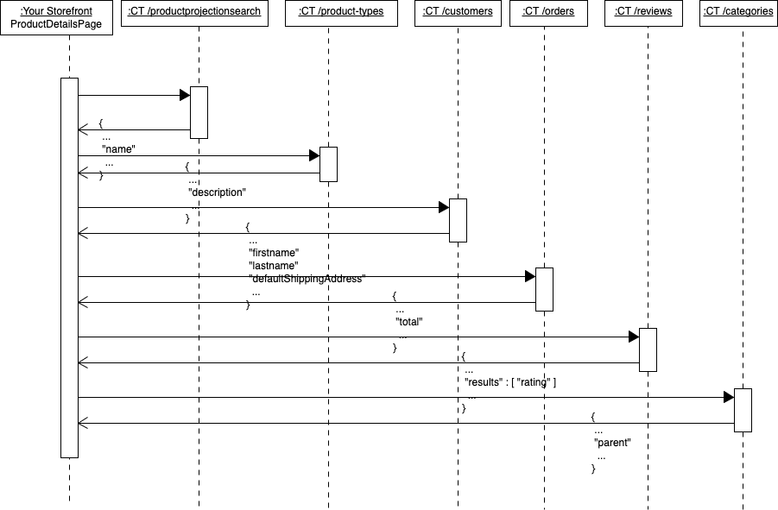
Rest
Challenges
overfetching
underfetching
multiple endpoints
Notes:
https://impex.europe-west1.gcp.commercetools.com/playground

Slide 13
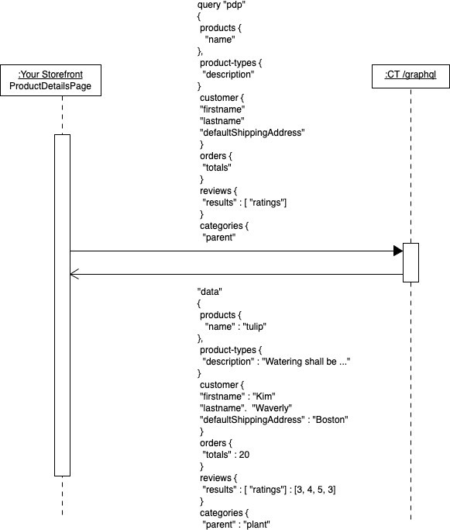
GraphQL
query language for REST/data servers
one endpoint
you can use same model used
for data fetching and
data delivering at client side
request only the data that you need
supports
fields, arguments, aliases
sorting, limitation
fragments, variables, directives, reference expansion
commerce tools covers
products, categories, channels, customer groups, product types, discounts
modification of resources is possible via mutations
Notes:
https://impex.europe-west1.gcp.commercetools.com/graphiql
https://graphql.org/code/: Node (https://americanexpress.io/graphql-for-the-jvm/), Apollo Android
also interesting: https://github.com/manifold-systems/manifold

Slide 14
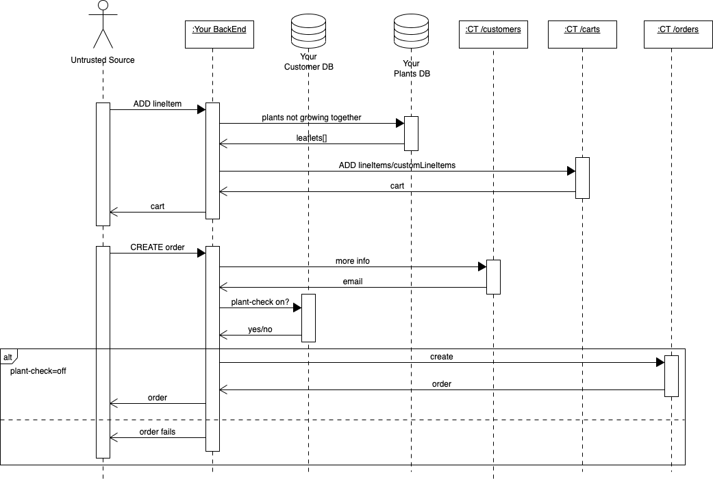
Implementation Draft v1
All Rights Reserved @2019

Slide 15

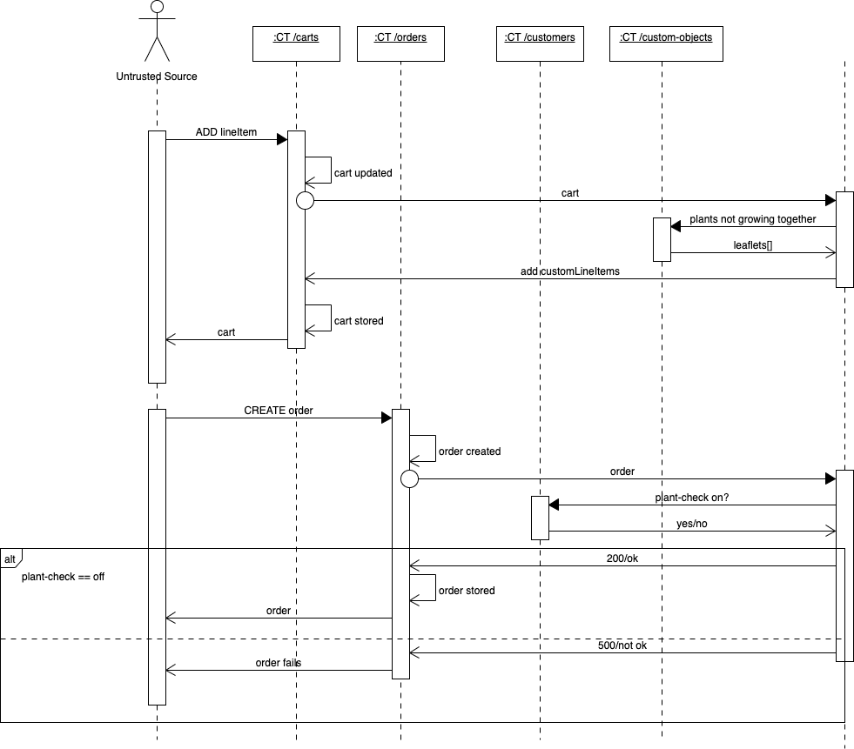


Implementation Draft v2
the serverless challenge
Link to Kelly talk
All Rights Reserved @2019

Slide 16










Integration approaches
Events
API Extensions
BFF
(middleware, backend-for-frontend)
AWS SNS /
SQS Queues
Google PubSub
Azure Queue
AWS Lambda Functions
Google Cloud Functions
Azure Cloud Functions
Custom Code
Examples:
Order submitted
Customer registered
Product published
Custom Code
Custom Code
Custom Code
Single-Page Application
Blueprint
Trusted Server

Slide 17
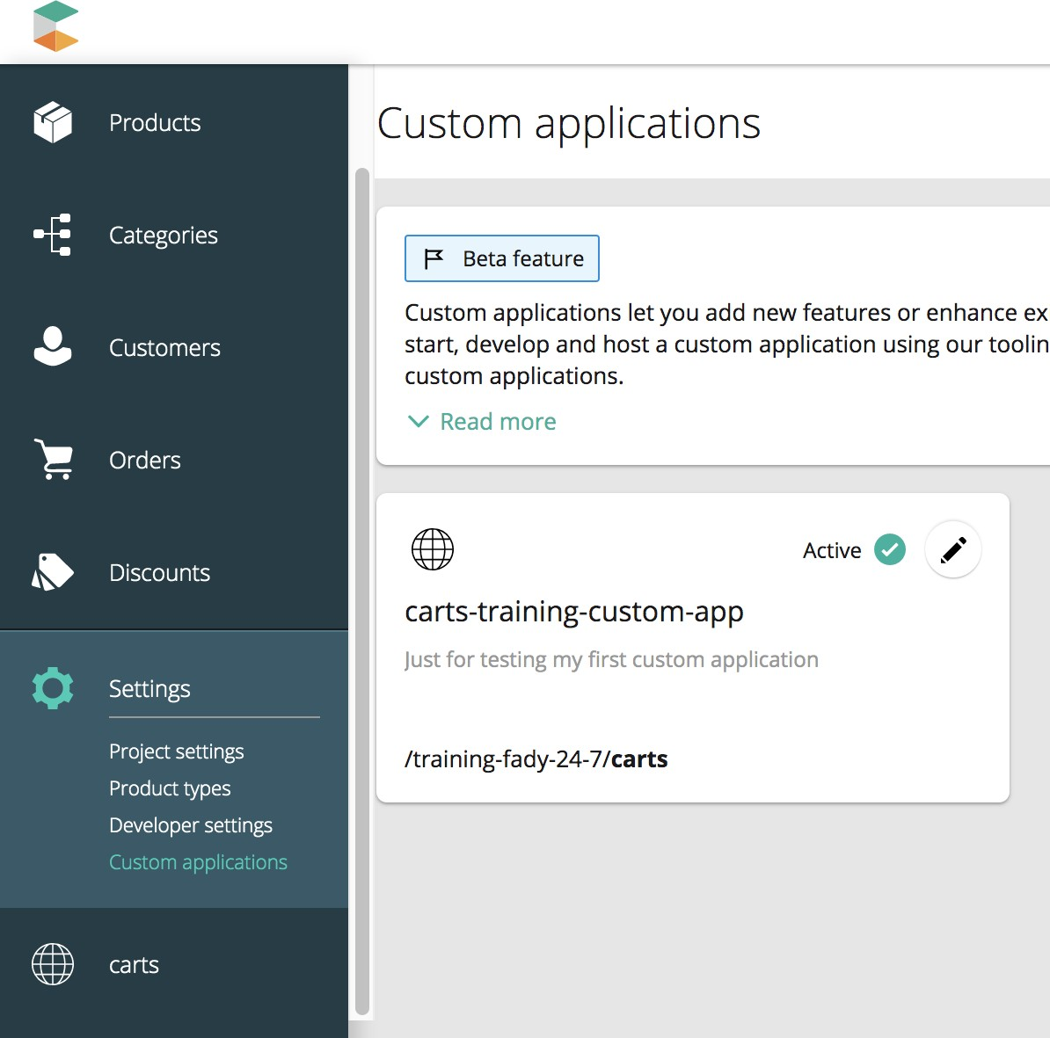
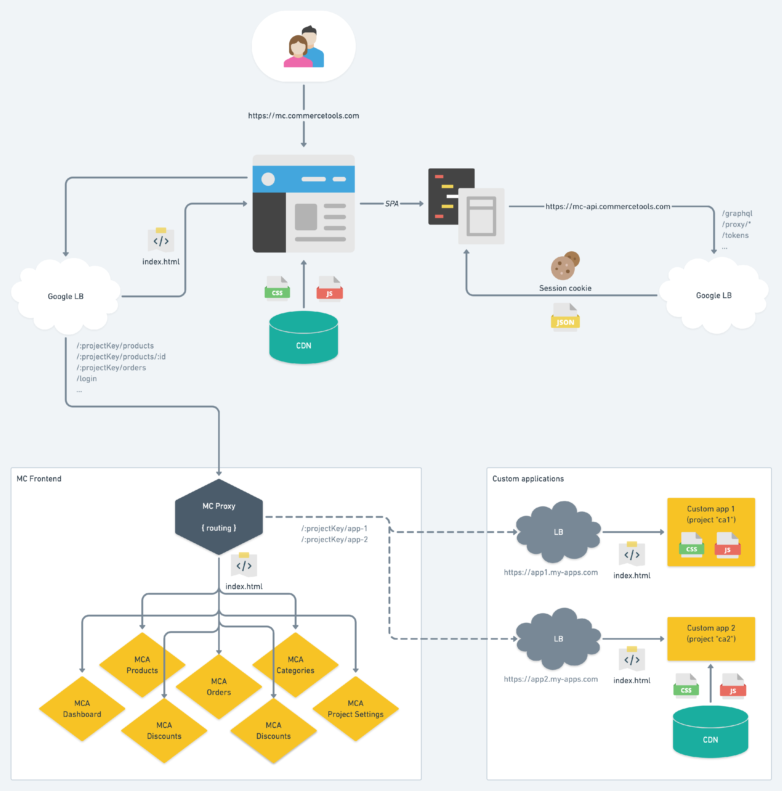
Merchant Centre Custom Applications

Slide 18
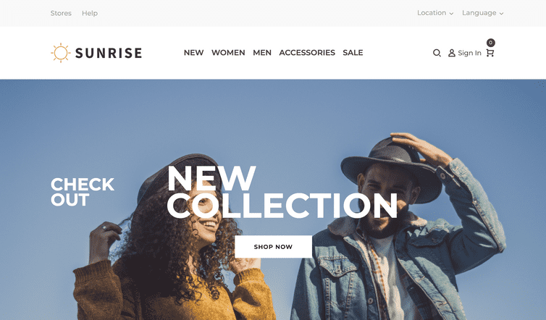
Project Starters
https://docs.commercetools.com/sdk/sunrise

Slide 19
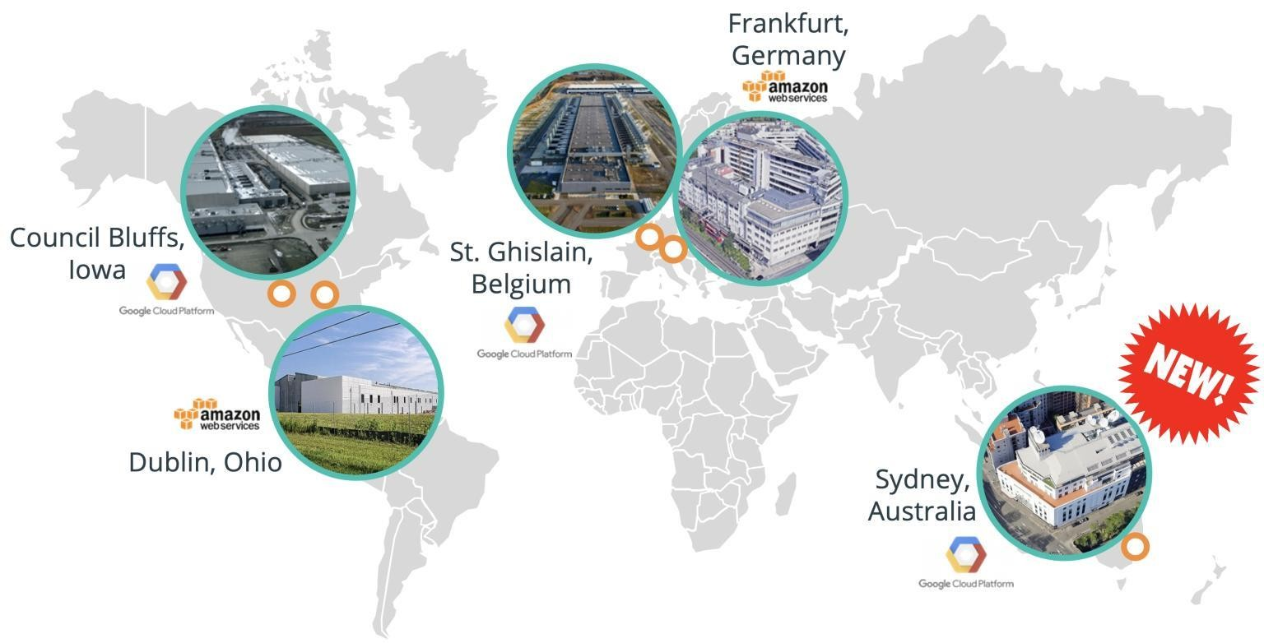
Global/Regional Touchpoints
 | … .commercetools.com
Github | https://github.com/commercetools
Training | https://learn.commercetools.com/
Platform Documentation | https://docs.commercetools.com/
Support | https://support.commercetools.com/
Status | https://status.commercetools.com/
Sunrise | https://demo.commercetools.com/
Marketplace | https://marketplace.commercetools.com/
 | … .{region}.{cloudProvider}.commercetools.com
Merchant Center | https://mc.europe-west1.gcp.commercetools.com/
API Playground & Impex | https://impex.us-central1.gcp.commercetools.com/
API | https://api.australia-southeast1.gcp.commercetools.com/
Authorization | https://auth.us-east-2.aws.commercetools.com/
Machine Learning | https://ml-eu.europe-west1.gcp.commercetools.com/

Slide 20


THANK YOU

